Slide 1
Landmasses and
Bodies of Water

Slide 2
Learning Objectives
At the end of the 1 hour lesson, the students should be able to:
Identify the landmasses and bodies of water that surrounds the Philippines;
Locate the landmasses and bodies of water that surrounds the Philippines using a map; and
Cite the importance of knowing the surrounding geography of an area in describing its location.

Slide 3
ATTENTION!
To help you achieve your learning objectives, unlock the ENCRYPTED WORDS to reveal important vocabulary terms.
ENCRYPTED WORDS
_{BSDIJQFMBHP}
_{DPOUJOFOU}
_{QFOJOTVMB}
_{HFPHSBQIZ}

Slide 4
Words to ponder
ARCHIPELAGO- is a group or chain of islands, especially small islands.
CONTINENT-is a very large area of land consist of several counties.
PENINSULA-is a long narrow piece of land which sticks out from a large piece of land and is almost surrounded by water
GEOGRAPHY- is the study of the Earths physical features.

Slide 5
Activity No. 2
Where in the World is the
Philippines? ( Part II)

Slide 6
Where in the World is the Philippines? ( Part II)
Objective
After performing this activity, you should be able to describe the location of the Philippines with respect to the surrounding landmasses and bodies of water.
What to use
Globe or world map
What to do
1. Using a globe o a world map as reference, label the blank map below.

Slide 7
Where in the World is the Philippines? ( Part II)
2. You labelled map should include the following:
A. Landmasses B. Bodies of Water
Philippine archipelago Philippine sea
Asian continent South China sea
Malay Peninsula Indian ocean
Indonesian archipelago Pacific ocean
Australian continent

Slide 8
Where in the World is the Philippines? ( Part II)
Guide Questions
Q1. Which bodies of water in the list are found to the west of the Philippines?
Q2. Which body of water in the list is located to the east of the Philippines?
Q3. Which large landmasses is found to the north of the Philippines?

Slide 9
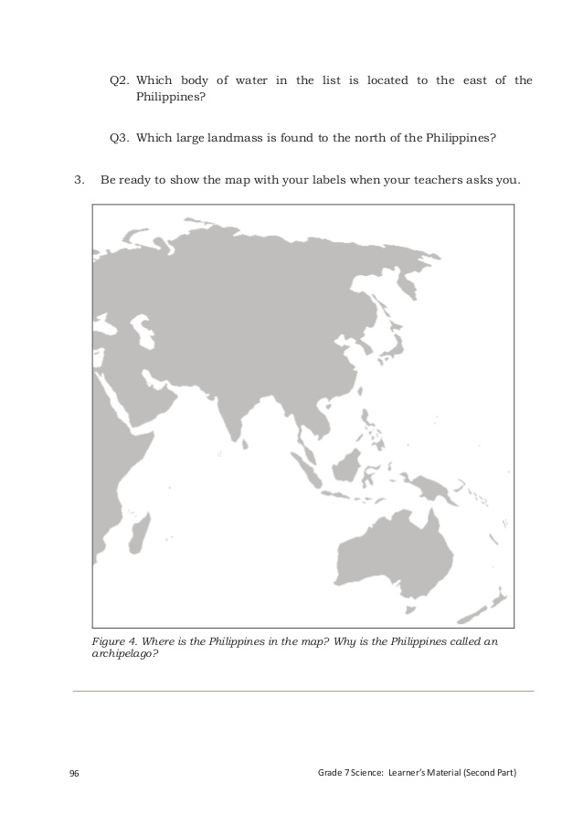
Where in the World is the Philippines? ( Part II)
3. Be ready to show the map with your labels.

Slide 10
Rubrics
Speed 10%
Teamwork 10%
Presentation 30%
Correctness of 50%
Entry ________
100%

Slide 11
Asian Continent
Pacific Ocean
Philippine Archipelago
South China Sea
Philippine Sea
Malay Peninsula
Indonesian Archipelago
Indian Ocean
Australian Continent

Slide 12
After performing the activity, can you now describe the location of the Philippines in the world?

Slide 13
Philippines is located in the southern part of the Asian continent. It surrounded by different bodies of water. To the west of the Philippines found the South China Sea (also known as the “West Philippine Sea” as called by the Philippine Government) and the Indian Ocean. To the east found the Philippine Sea and the Pacific Ocean.
Philippines is called an archipelago because the country is made up of group or chain of islands.
Philippines is made up of 7 109 islands.

Slide 14
Assignment
Describe the location of Japan with respect to its surrounding landmasses and bodies of water.
How does our latitude position affect the water, soil resources, and biodiversity in the county?

Slide 15
Reference:
Globe or World map
Science 7 Leaners Manual (Module 2) pp. 87-91

Slide 16
Thank you for Listening!

